Slide 1
Semantic segmentation of brain tumors in multimodal magnetic resonance imaging (MRI)

Slide 2
TASK
For the input MRI volume output per-pixel classification for:
Edema
Non-enhancing tumor
Enhancing tumor

Slide 3
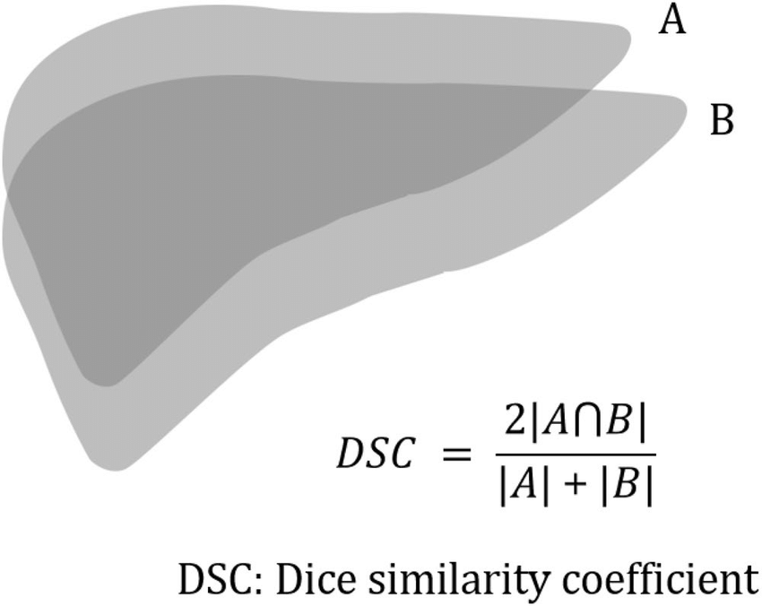
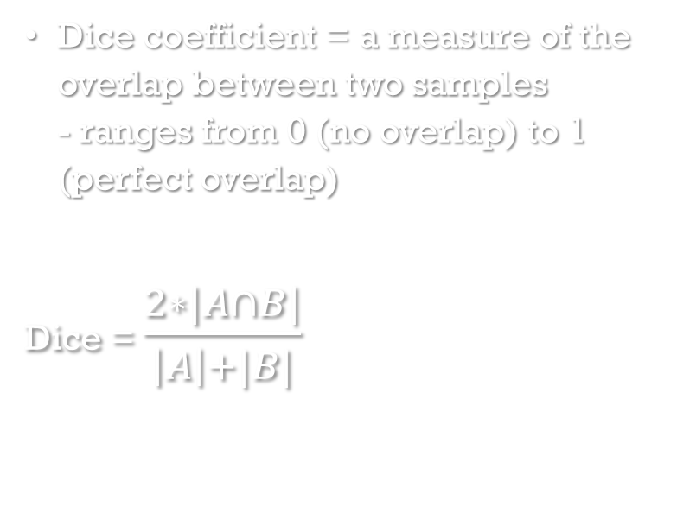
EVALUATION METRIC
Dice coefficient = a measure of the overlap between two samples - ranges from 0 (no overlap) to 1 (perfect overlap)
Dice = $\frac{2∗|A∩B|}{\left|A\right|+|B|}$

Slide 4
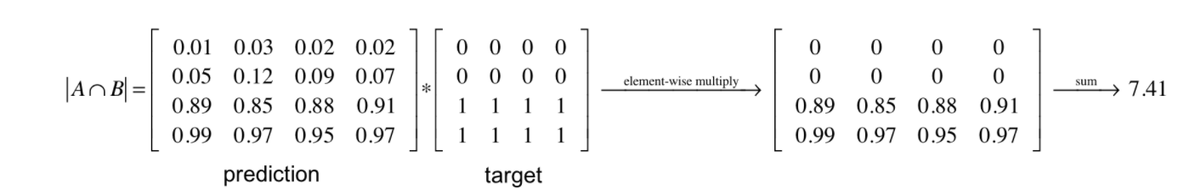


Dice = $\frac{2∗|A∩B|}{\left|A\right|+|B|}$
3 classes: average Dice
We can approximate |A $∩$ B| as the element-wise multiplication between the prediction and target mask and then sum the resulting matrix

Slide 5
RESULTS
For all generated models:
Batch size = 1
Number of epochs = 10
3 models generated with different learning rates

Slide 6
First model
Third model
Second model
learning rate = 0.00001
7740 training patches and 1940 validation patches
validation Dice coefficient of 0.7922
learning rate = 0. 01
11610 training patches and 2910 validation patches
validation Dice coefficient of 0.7946
learning rate = 0.1
11610 training patches and 2910 validation patches
validation dice coefficient of 0.7975
 |  | Edema | Non-enhancing tumor | Enhancing tumor
Model 1 | Sensitivity | 0.0027 | 0.0009 | 0.0059
 | Specificity | 0.7471 | 0.211 | 0.001
Model 2 | Sensitivity | 0.0016 | 0.0021 | 0.0037
 | Specificity | 0.3593 | 0.0485 | 0.0004
Model 3 | Sensitivity | 0.0011 | 0 | 0.0046
 | Specificity | 0.7942 | 0.7317 | 0.0001
Notes:
The learning rate controls how quickly the model is adapted to the problem. Smaller learning rates require more training epochs given the smaller changes made to the weights each update, whereas larger learning rates result in rapid changes and require fewer training epochs.
A learning rate that is too large can cause the model to converge too quickly to a suboptimal solution, whereas a learning rate that is too small can cause the process to get stuck.

Slide 7
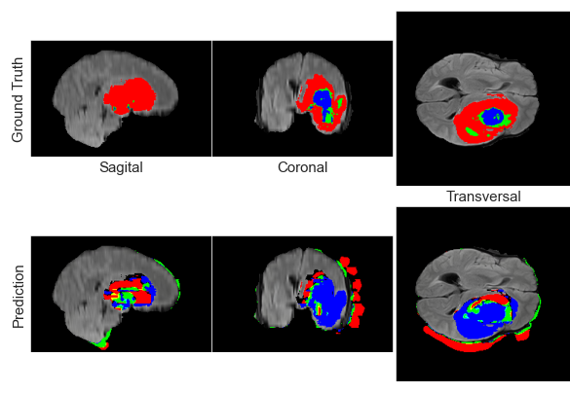
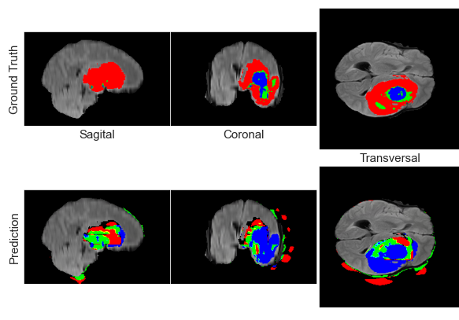
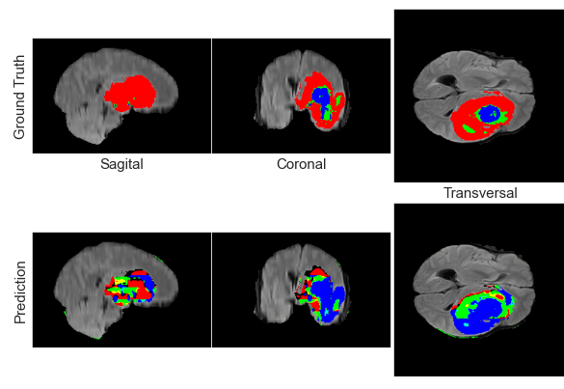
Comparison of 3 models visually
Red is edema
Green is a non-enhancing tumor
Blue is an enhancing tumor

Slide 8
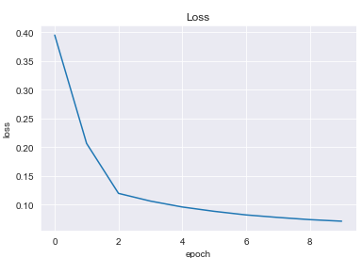
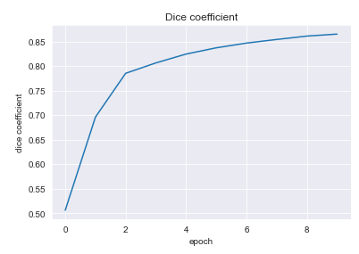
conclusion
Due to large dataset, model learned to recognize regions that contain one of the 3 classes which compensated for short training time
Training should be continued for better results

Slide 9
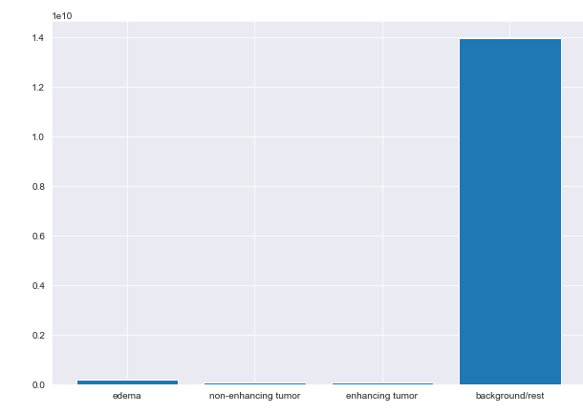
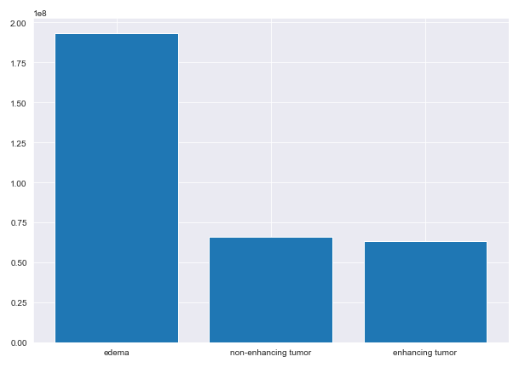
imbalanced classification problem
Edema: 1.35%, non-enhancing tumors: 0.46% enhancing tumor: 0.44%
Almost 98% of training data doesn’t contain positive classes – model has very small amount of data to learn from although the dataset is large

Slide 10
rebalancing strategies
Data-level approach:
randomly oversampling the minority class and/or under-sampling the majority class
generating synthetic instances to improve classifiers’ performance
Algorithm-level approach:
cost-sensitive learning - different types of prediction errors have different and known associated costs
Notes:
We have to think about which is more disastrous? To tell a healthy person they have the disease or to tell a person with the disease that he is healthy? Of course it is more disastrous to tell a person with a disease he is healthy as this can have detrimental effects. If we tell a healthy patient he has the disease he can easily get more testing done and discover he is healthy.

Slide 11
learning outcome
Developed theoretical and practical knowledge about deep learning
Improved programming skills (programmed parts of the code myself ☺ )
Intuition about issues of implementation of such algorithms
Passion for deep learning and continuation of work

Slide 12
THANK YOU FOR YOUR ATTENTION ☺

